Slide 1
Black Machines
February 21, 2017

Slide 2
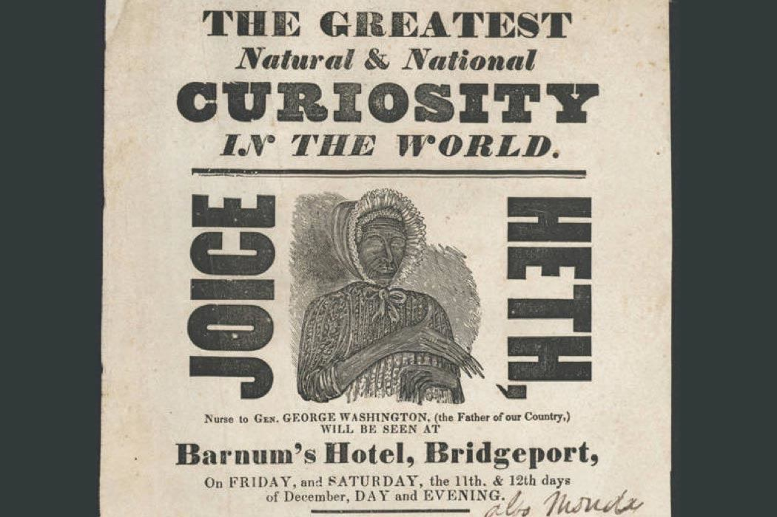
“Joice Heth is not a human being.”

Slide 3
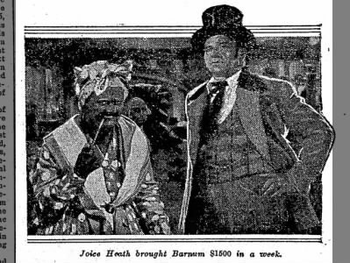
Notes:
Portrayal of Heth and Barnum from the Potsville Herald, 1935

Slide 4
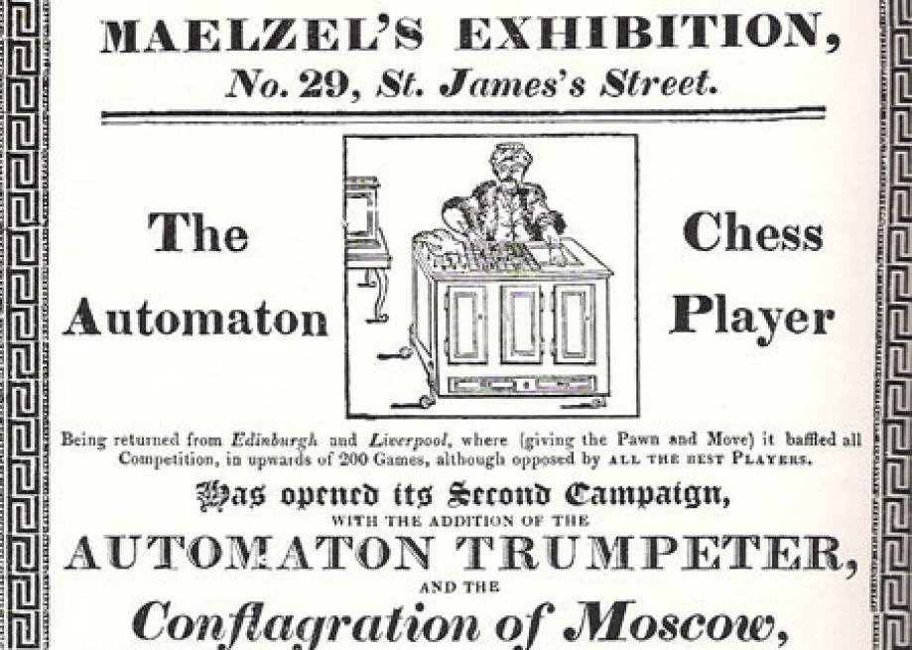
Notes:
An exhibition ad from 1818.

Slide 5
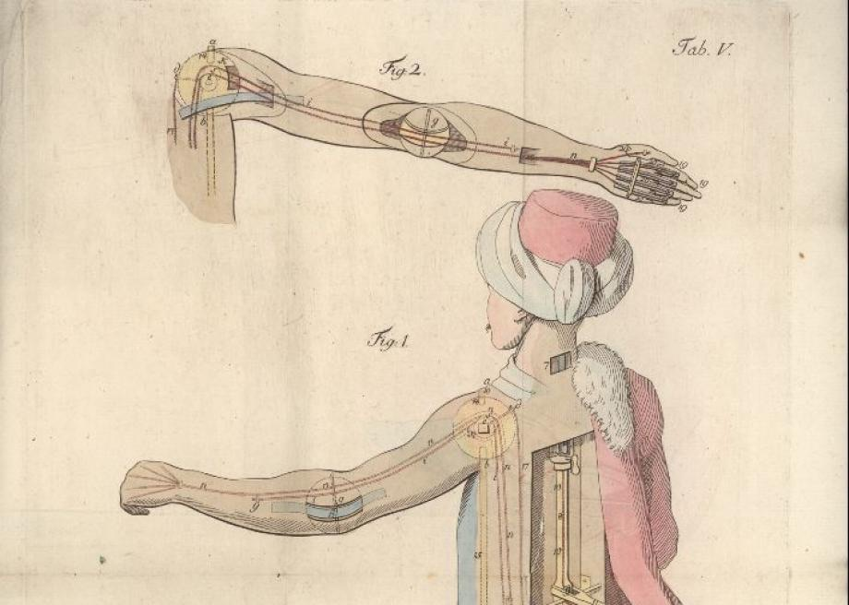
Notes:
The inner workings of the Turk's arm, as envisioned by Joseph Racknitz.

Slide 7
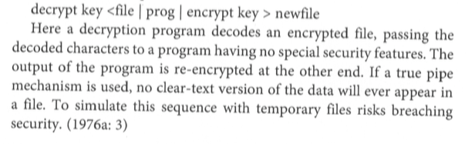
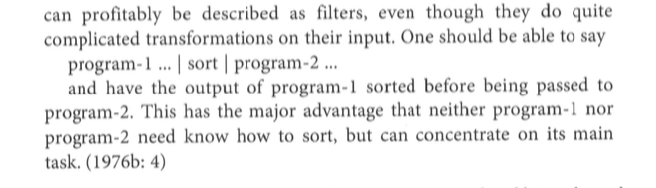
Modularity

Slide 8
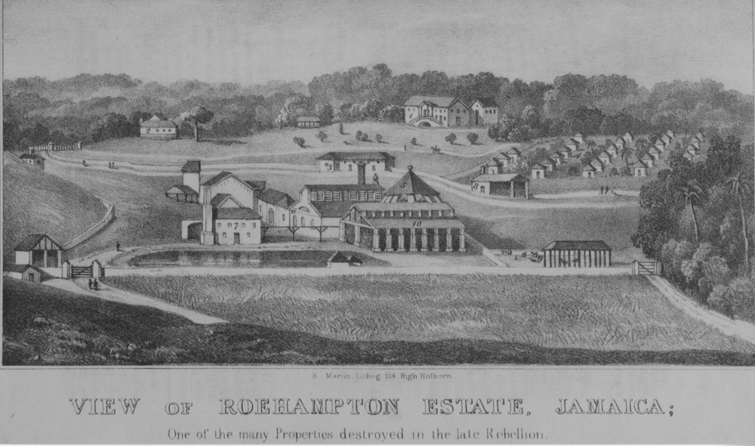
Plantation as OS | Slavery as OS

Slide 9
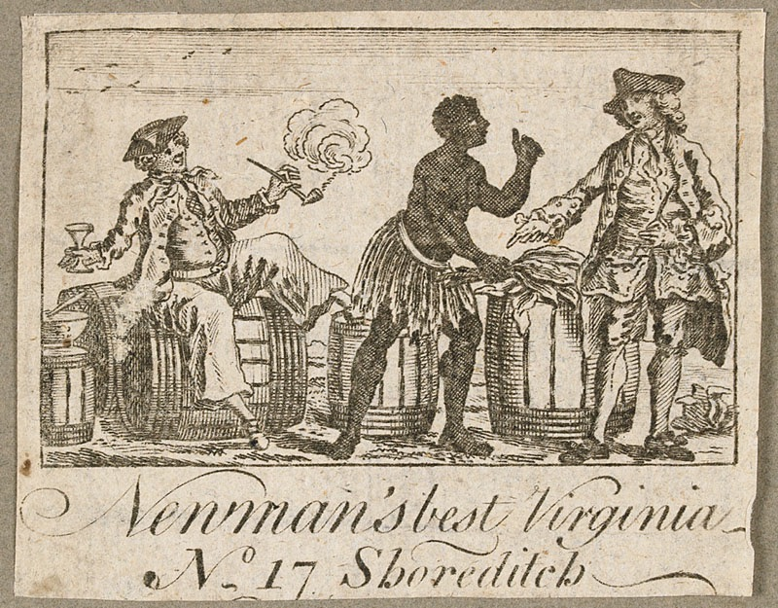
“Negro-in-the-machine”

Slide 11
What is Black Twitter?
“These insights will ultimately express how from analog to digital, the black other is almost always implicated in or conscripted by a white need to make sense of new relationships to new technologies as they “creep into his person.” And these technologies accomplish this fearsom invasion of the self initially by way of imitation—by “nature” mimicking and therefore drawing attention to the “element of automatism” that is already there but masked as ”nature.”
Sambo. Comic/Comedy. Minstrelsy.
“...WE LAUGH EVERY TIME A PERSON GIVES US THE IMPRESSION OF BEING A THING.”
Black Machines
“...”we” fear and dread the moment whenever a thing gives us the impression of being a person.”
Robot (1922)

Slide 12
Interdisciplinary as hybridity – Black Studies as Praxis
Ethnic Studies, Black Studies, Women’s Studies have worked hard to decode operating systems, i.e. to think through difference, see contexts, capture process
The metalanguage of race – Evelyn Brooks Higginbotham
Intersectionality – Kimberlé Crenshaw
Jeopardy – Deborah King
Being Human as Praxis – Sylvia Wynter
Antiblackness – Christina Sharpe, Simone Browne, Afrxlatinidad
Advanced Marginalization – Cathy Cohen
Fugitivity – Fred Moten, Jasmine Cobb
Infrapolitics – Robin D. G. Kelley riffing on James Scott
Thingification - Aimé Césaire
Hybrid knowledges – Tara McPherson
Chude-Sokei, p. 121

Slide 13
Black Code Studies

